Slide 1


Slide 2
What is db
IS a collection of data stored in a format that can easily be accessed.

Slide 3

To manage database
In order to manage Database we use software to do that (database management system “DBMS”)

Slide 4

We have several DBMS and they are classified into two categories

Slide 5
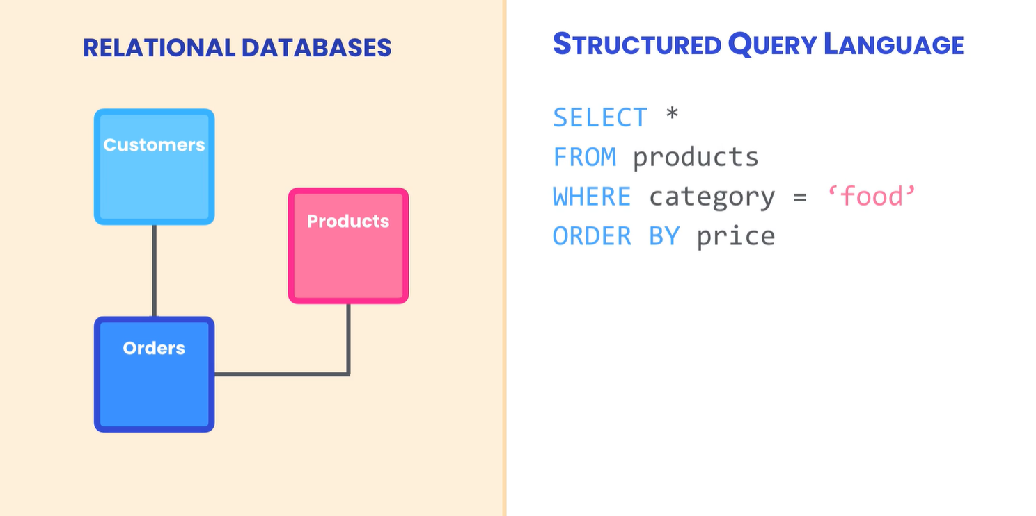
Relational database

Slide 6
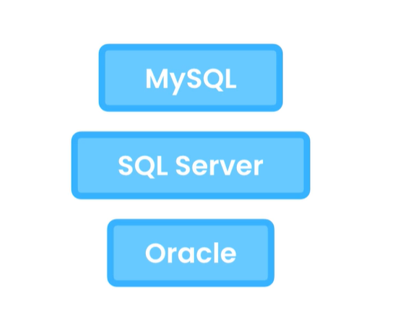
Relational database management systems (RDBMS)

Slide 7


Slide 8


Slide 9


Slide 10


Slide 11
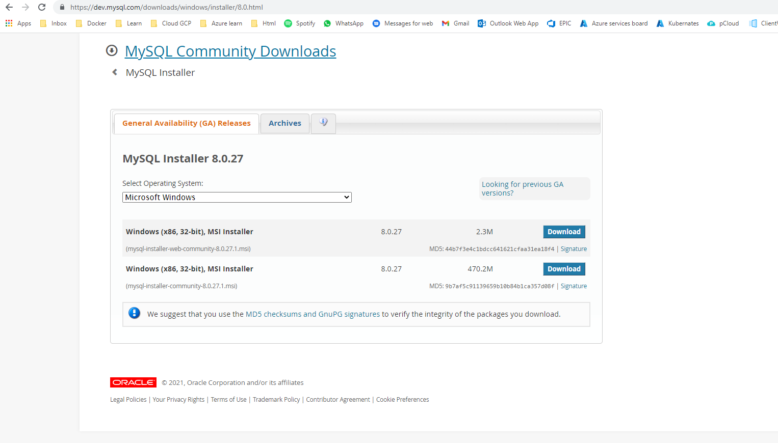
Installing Mysql (step 1)
https://dev.mysql.com/downloads/windows/installer/8.0.html direct link

Slide 12
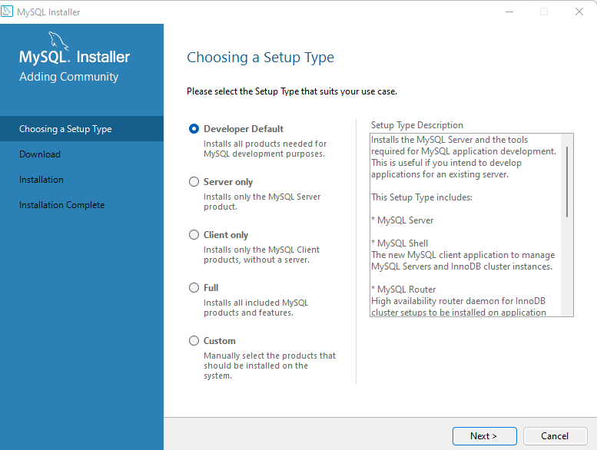
Installing Mysql (step 2)

Slide 13
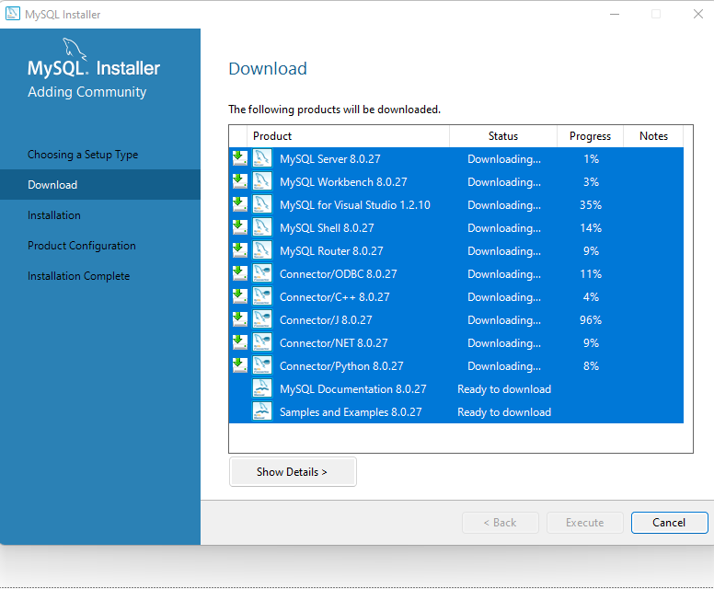
Installing Mysql (step 2) Click on execute

Slide 14
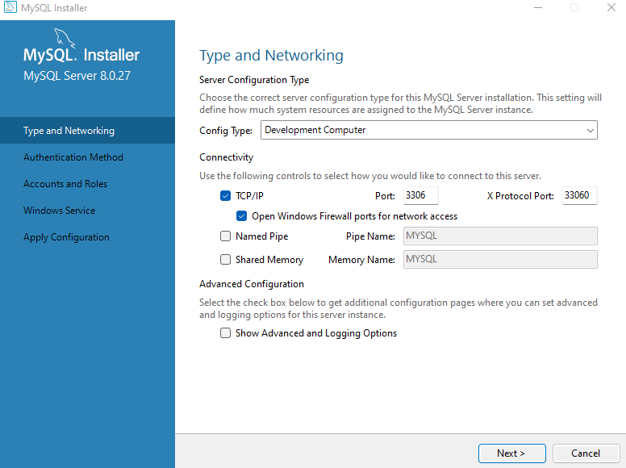
Installing Mysql (step 3) Click on next

Slide 15
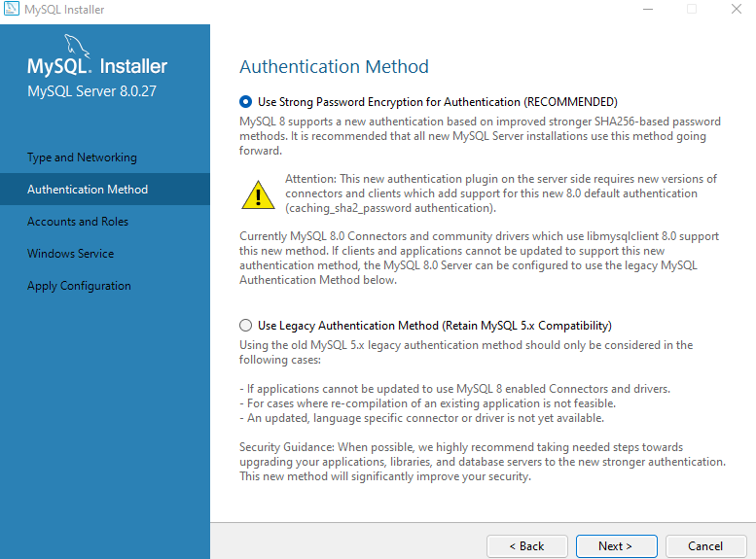
Installing Mysql (step 4) Click on next

Slide 16
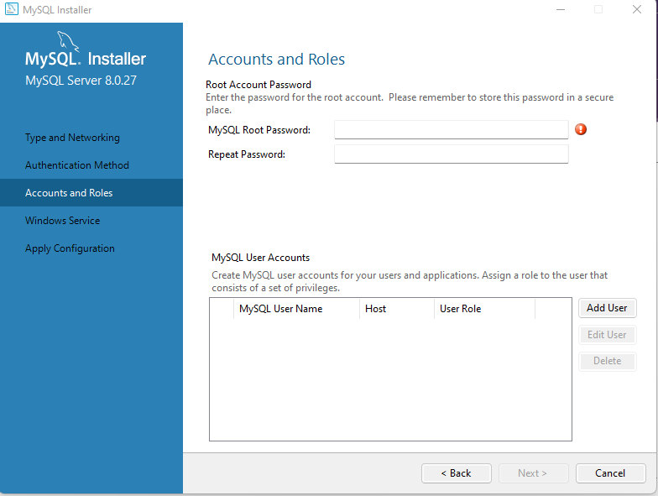
Installing Mysql (step 5) Click on next
Username = admin password = admin

Slide 17
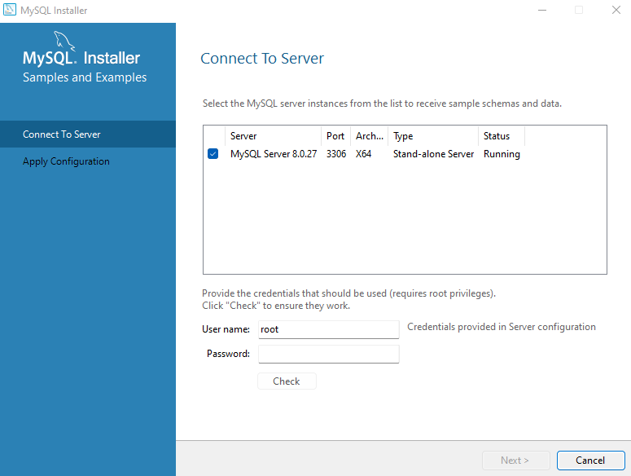
Password = admin
Root is the admin user

Slide 18
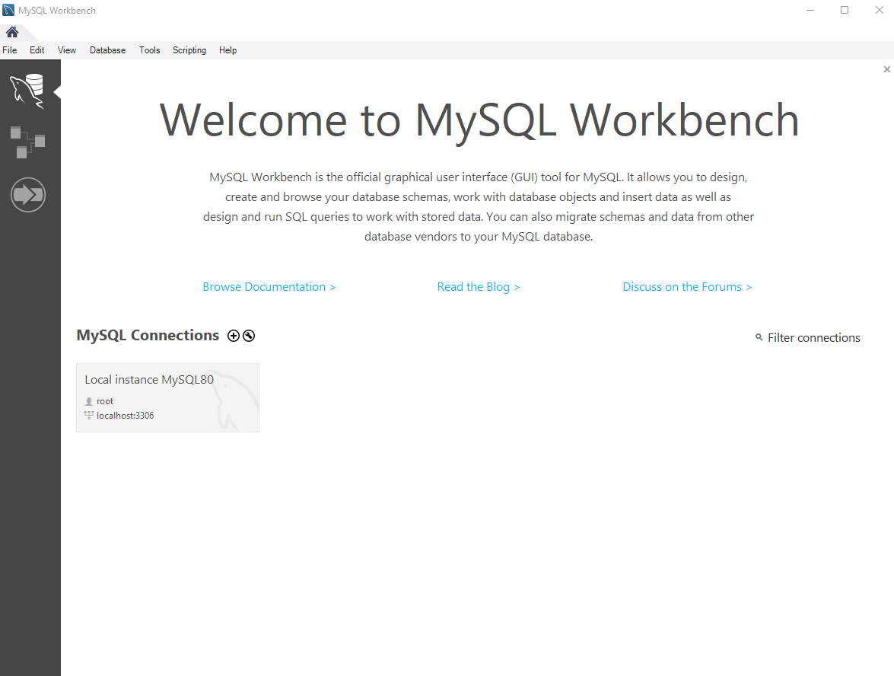
Welcome to MySQL

Slide 19
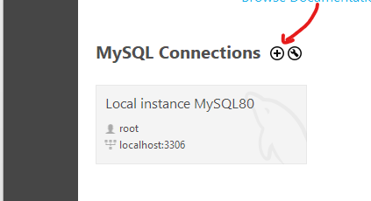
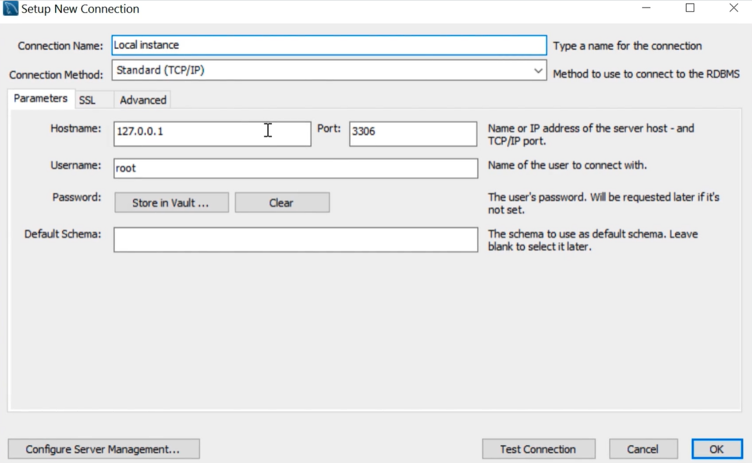
If u don’t see connection click on +

Slide 20
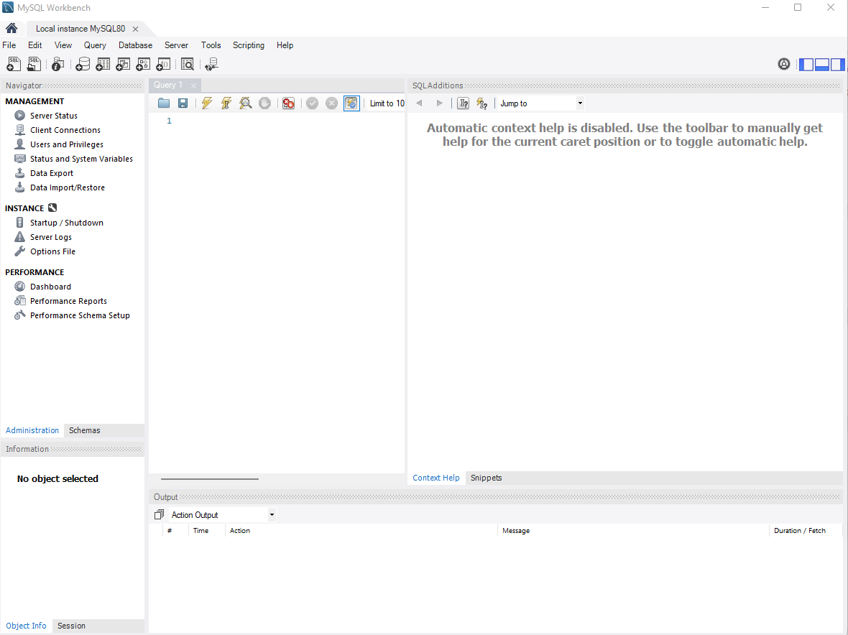

Slide 21
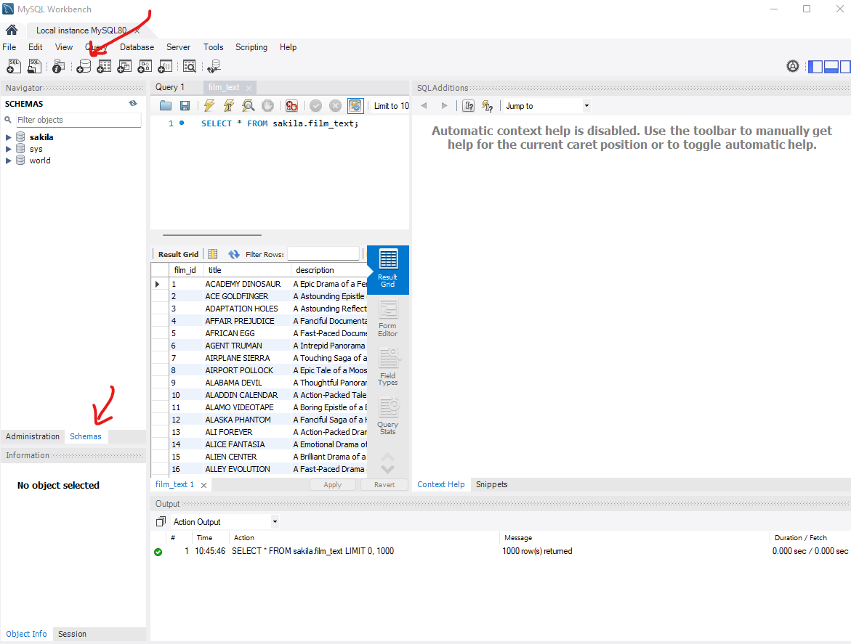
Creating database

Slide 22
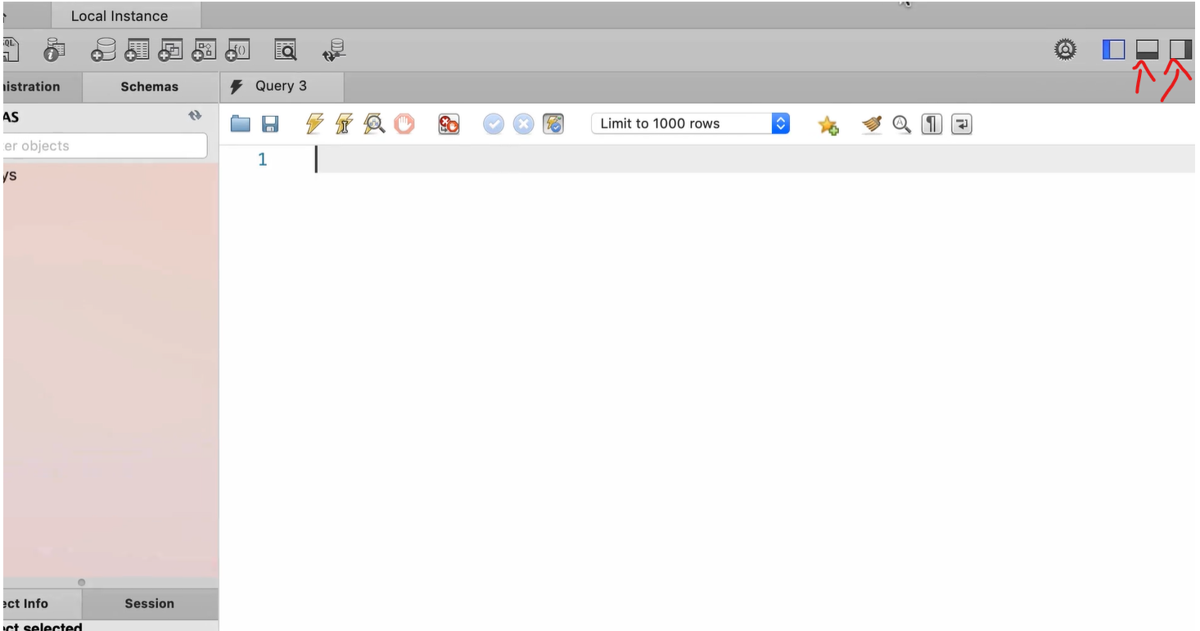
Hide panels

Slide 23
Downloads files

Slide 24
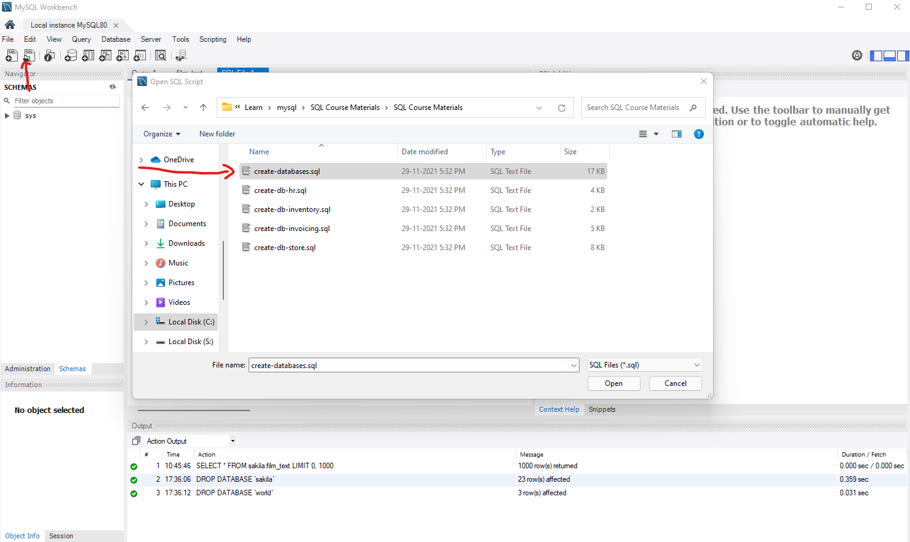
Load create-database.sql script

Slide 25
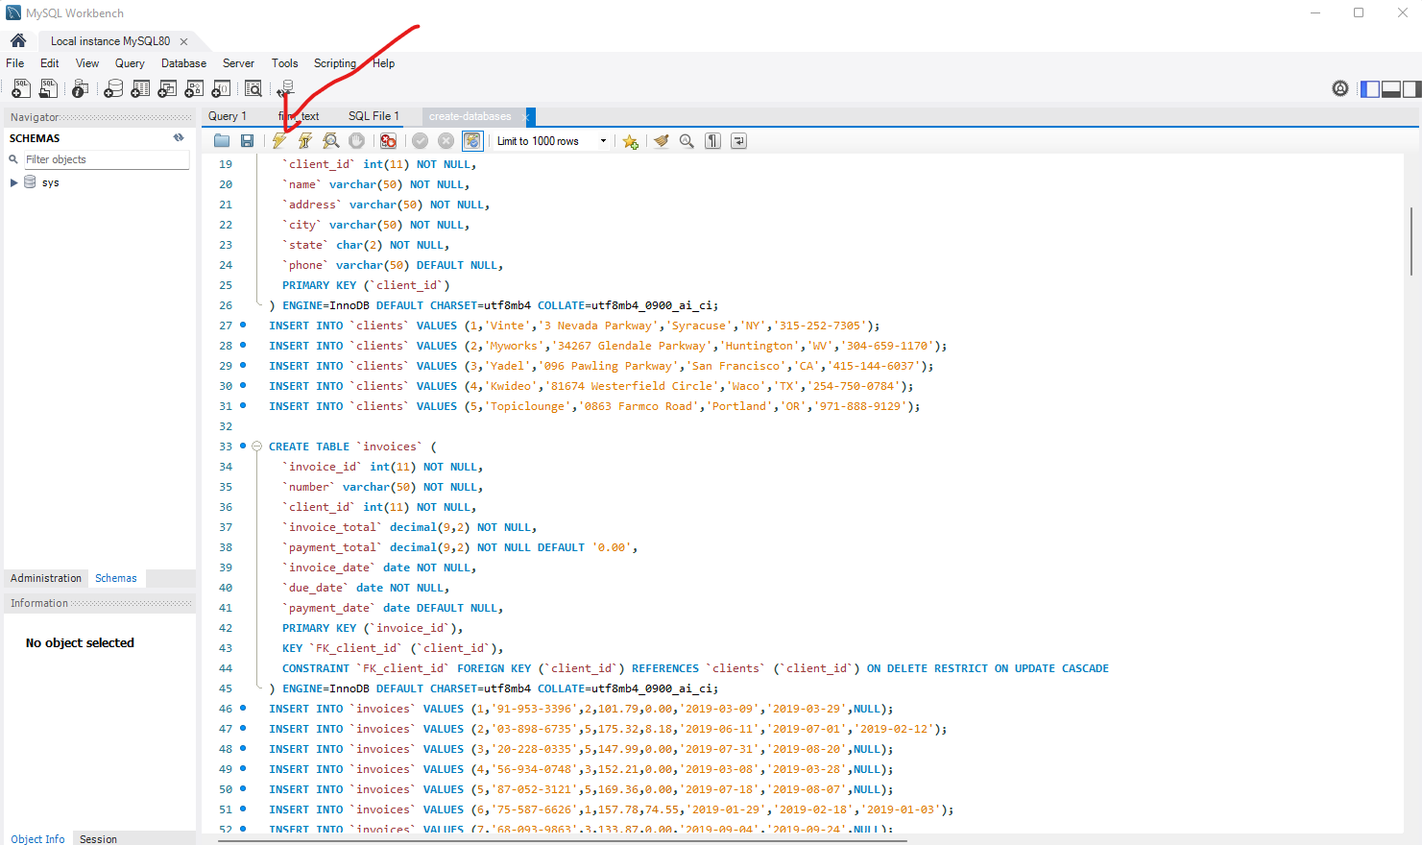
Execute script

Slide 26
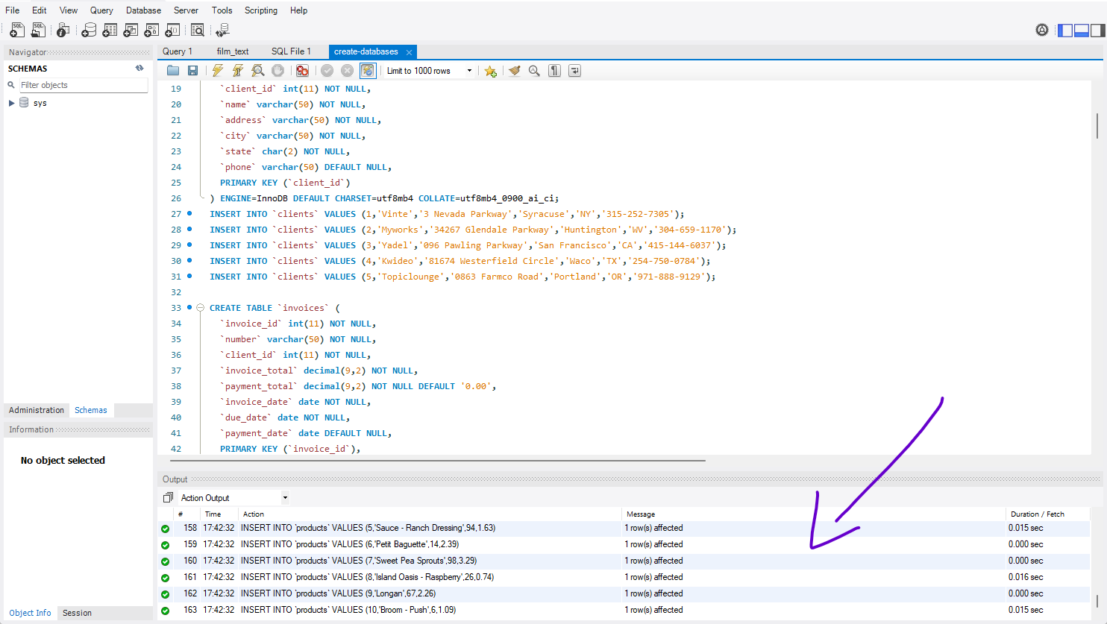
Output window

Slide 27
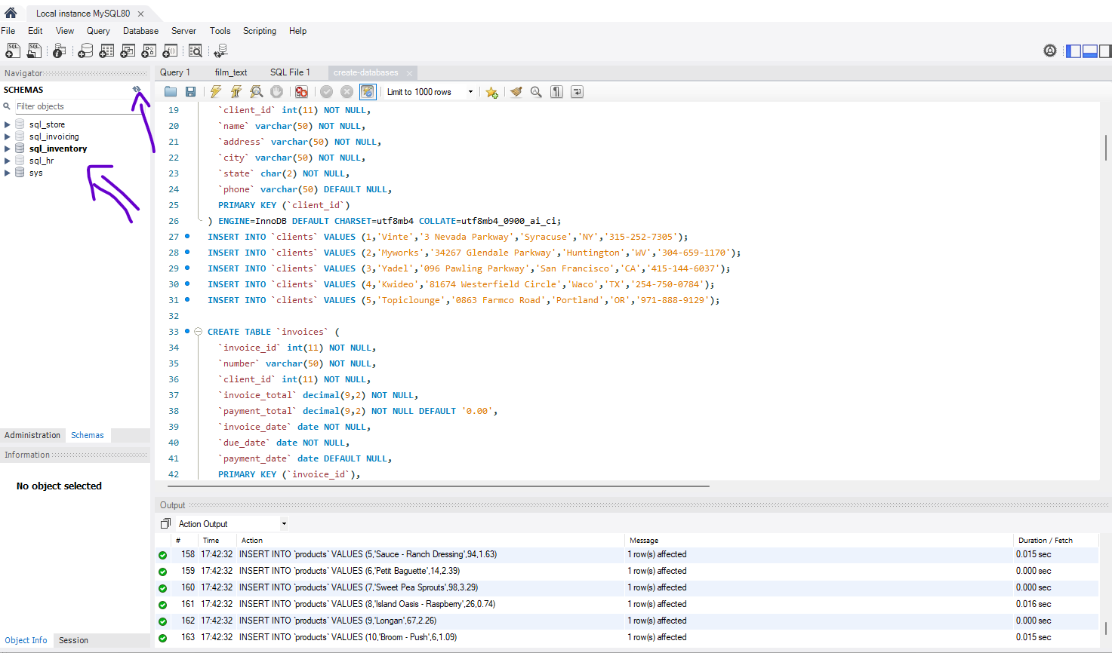
Refresh View

Slide 28
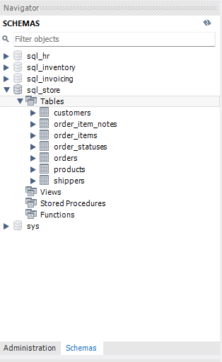
Database explore
Tables where we stored our data.
Views its kind of virtual tables, so we can combine data from different tables and put them in view, its especially powerful in creating reports.
Stored procedures and Functions data programs stored inside our database to querying data, for example we can have stored procedure that return all the customers in given city.

Slide 29
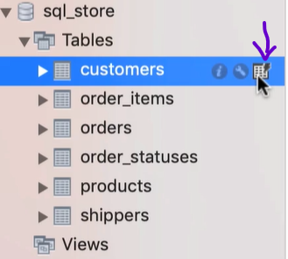
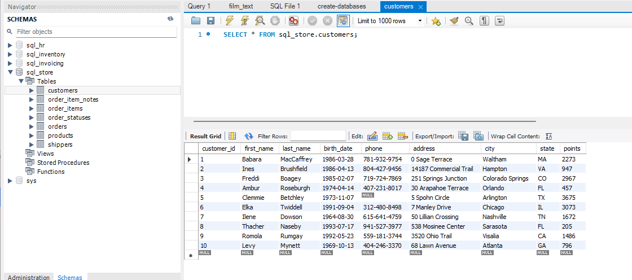
Show data from table

Slide 30
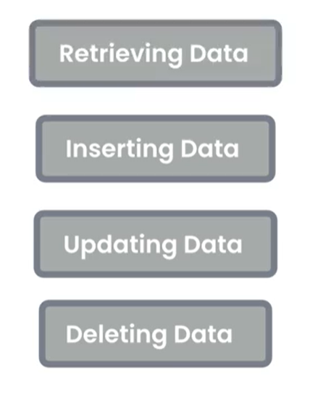
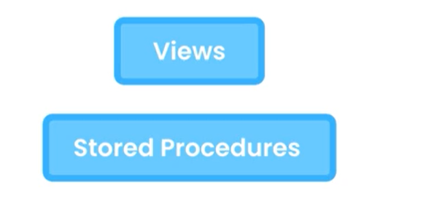
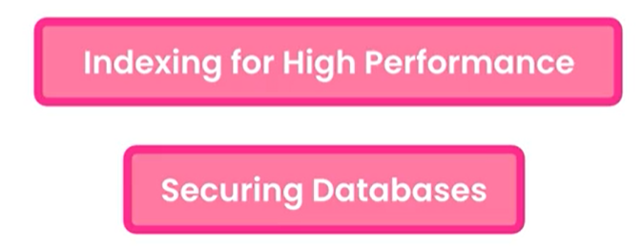
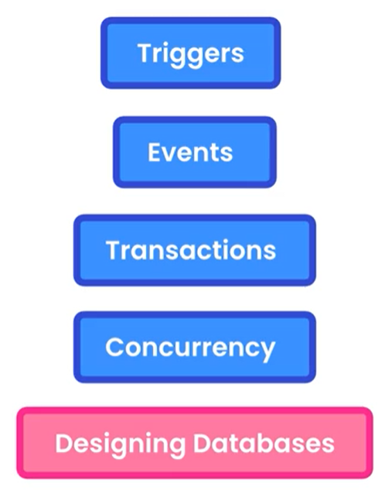
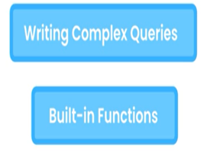
What You Will Learn

Slide 31
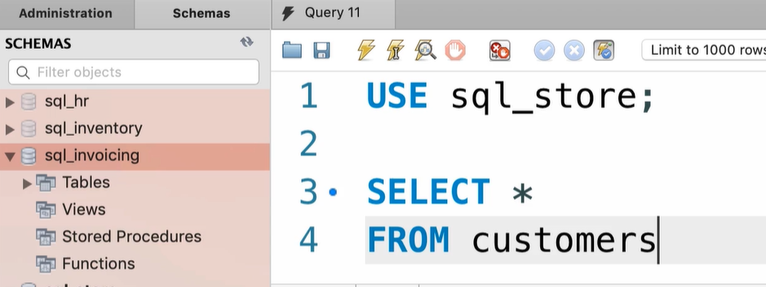
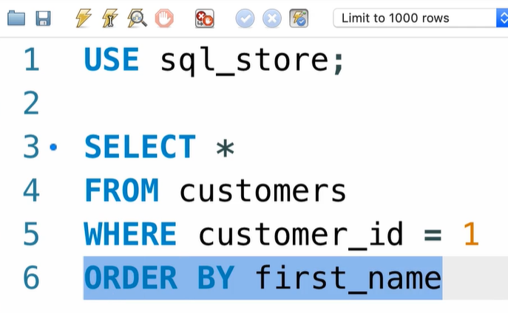
The SELECT Statement

Slide 32
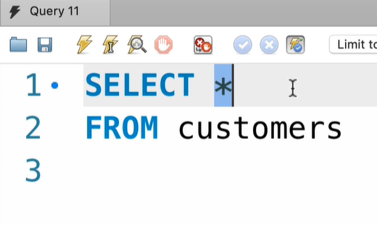
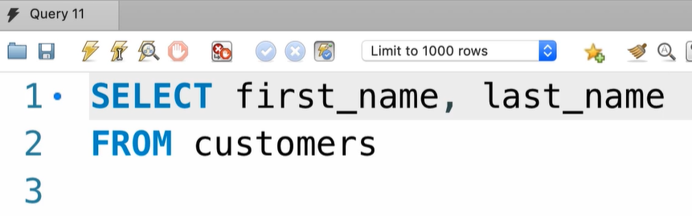
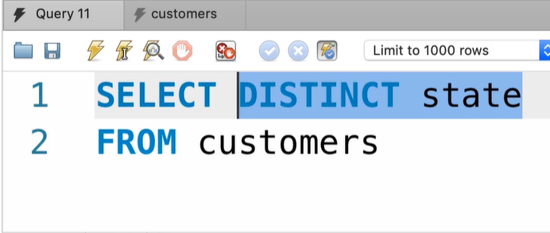
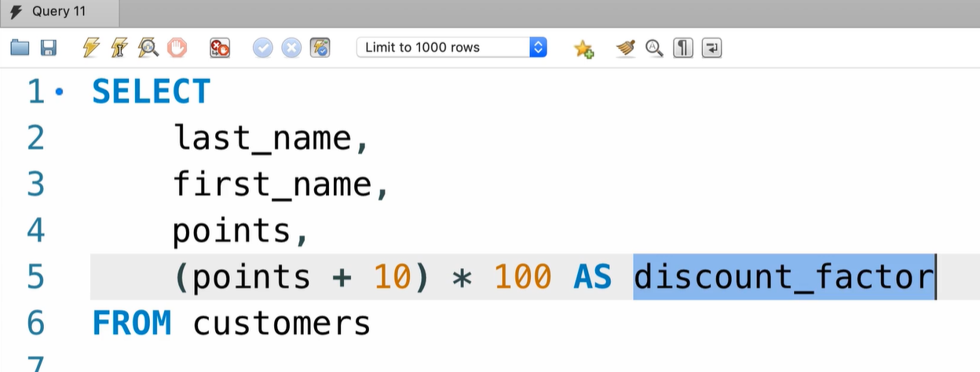
The Select clause
All the data
Custom columns
Unique data
Use arithmetic expressions

Slide 33
Exercise
Return all the products
-- name
Unit price
New price (unit price * 1.1)

Slide 34
Solution

Slide 35
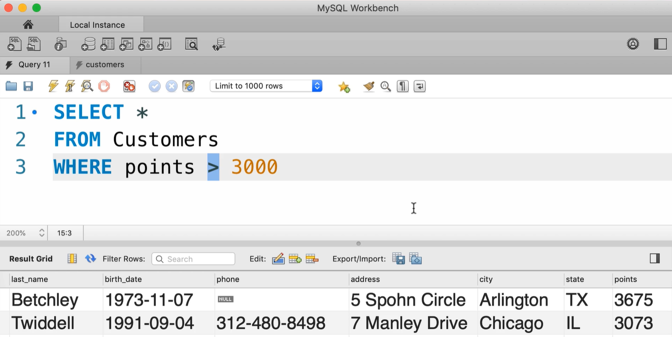
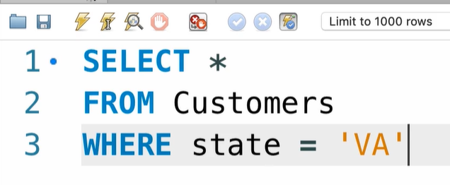
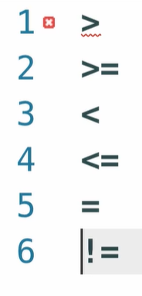
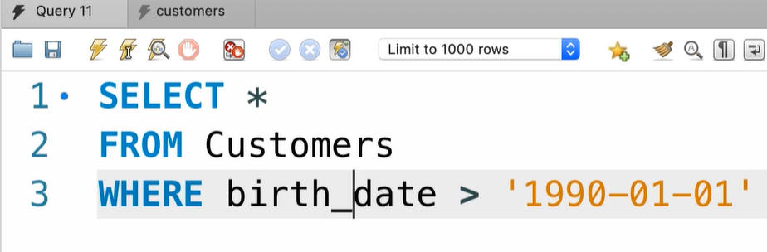
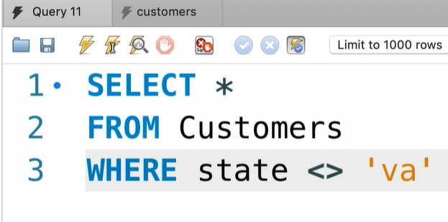
Where Clause

Slide 36
Exercise
Get the orders placed this year

Slide 37
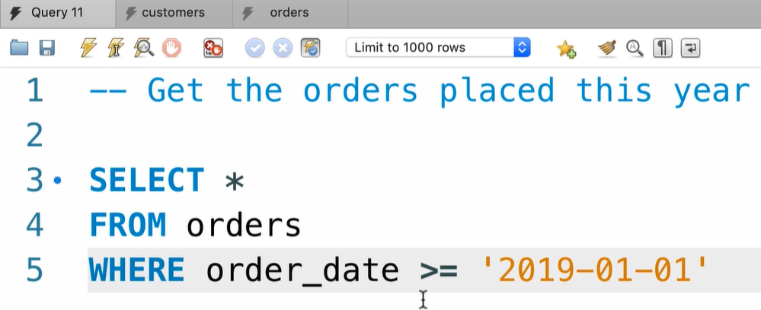
Get the orders placed before three years

Slide 38
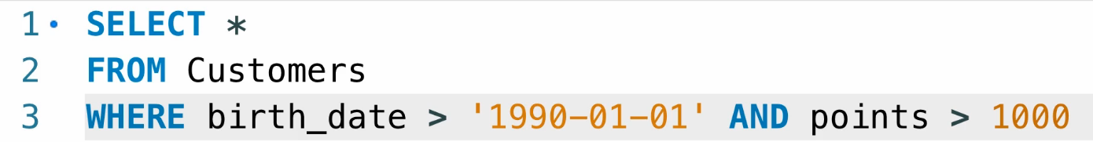
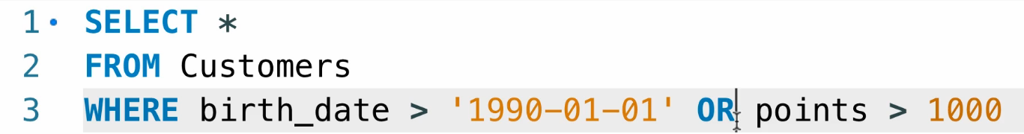
The AND, OR and NOT Operators

Slide 39
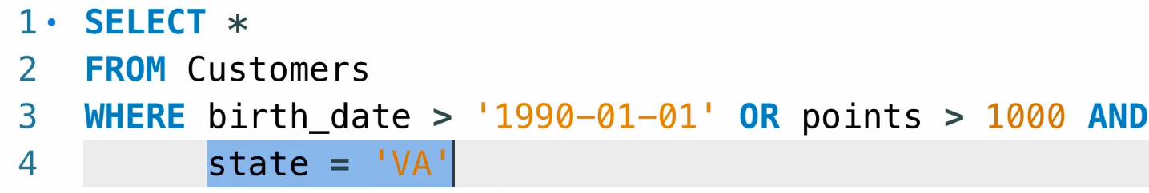
Multiple conditions
When u work with multiple conditions remember that the order is matter, the AND is more then strong then the OR. AND will be evaluated first

Slide 40
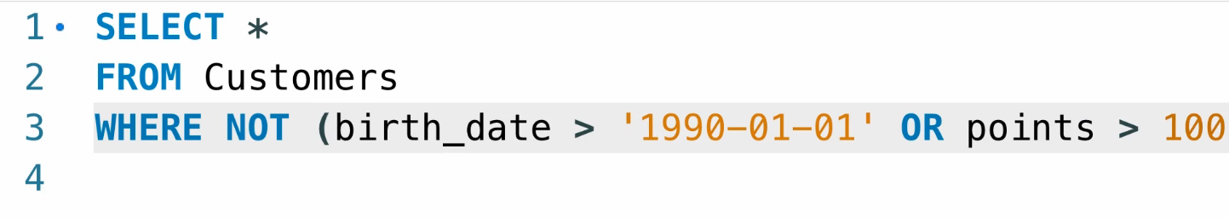
WHERE NOT operator

Slide 41
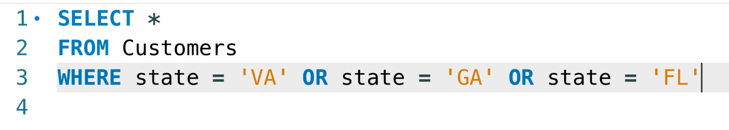
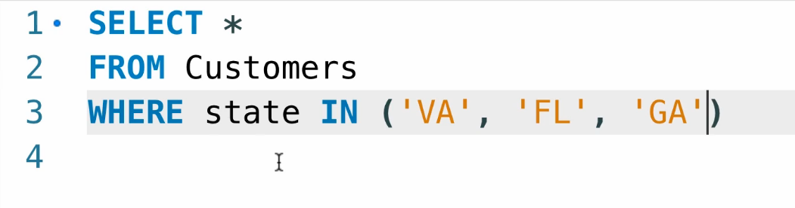
The IN operator
Get customers that located in Floridian Gorgia and Virginia

Slide 42
Exercise
Write a query that get products where the quantity in stock equal to 49, 38, 72

Slide 43
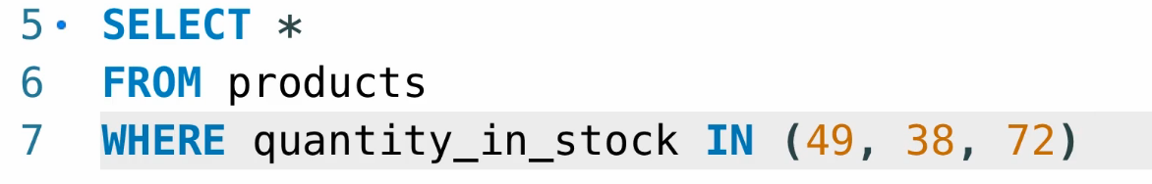
Solution

Slide 44
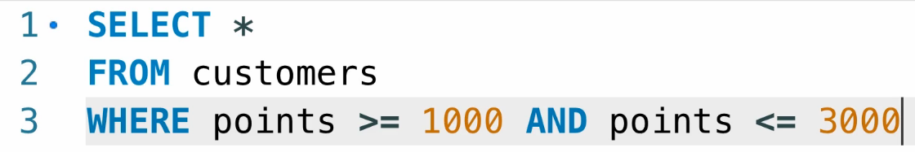
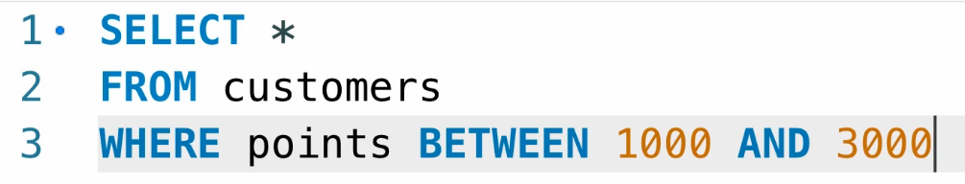
BETWEEN Operator

Slide 45
Exercise
Write query to return customers born between 1/1/1990 and 1/1/2000

Slide 46
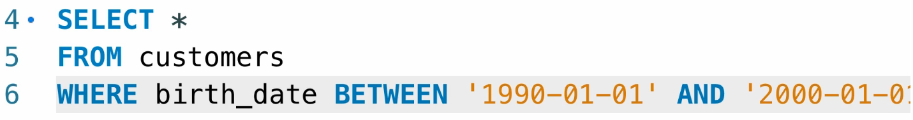
Solution

Slide 47
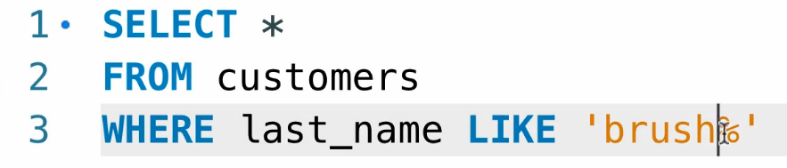

LIKE Operator %
Get customers there last name start with brush
Customer that there is b in there last name anywhere

Slide 48

LIKE Operator _
Search for single character For example, last name that start with 4 characters and end with y

Slide 49

NOT LIKE Operator
Phone numbers not end with 9

Slide 50


REGEXP
Regular expressions powerful for searches based on string patterns, and it allow us to search data with complex search pattern
String start with ^
End of string $
Or |

Slide 51
Exercise
Find customers that end with EY or ON
Find customers names are ELKA or AMBUR

Slide 52


Solution

Slide 53



IS NULL Operator

Slide 54

Exercise
Get the orders that are not shipped

Slide 55

Solution

Slide 56



Sorting data - ORDER BY Operator

Slide 57

Exercise
Only have the items sorted by the total price

Slide 58

Solution

Slide 59

LIMIT number of records return from query

Slide 60

LIMIT Paging
Skip first 6 record and then return 3

